Slide 1
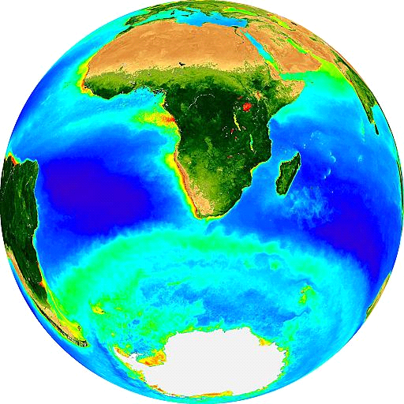
Introduction to Marine Biogeochemistry
Dr. Sarah Fawcett
sarah.fawcett@uct.ac.za
134.1 R.W. James
Office hours: Th 3-5 pm
22 May 2017

Slide 2
bio-geo-chemistry

Slide 3
bio-geo-chemistry
The study of the biological, geological, chemical, (and physical) processes and relationships that control the composition of the natural environment

Slide 4
Biogeochemical cycles
Transport and transformation of chemical elements through the biotic (living) and abiotic (non-living) compartments of the Earth - return to the starting point after a series of changes (can be repeated).
Reservoir: “pool” in which chemical accumulates for a period of time (e.g., ocean, organic biomass)
Flux: transformation (movement) of a chemical from one reservoir to another

Slide 5
Biogeochemical cycles
Transport and transformation of chemical elements through the biotic (living) and abiotic (non-living) compartments of the Earth - return to the starting point after a series of changes (can be repeated).
Reservoir: “pool” in which chemical accumulates for a period of time (e.g., ocean, organic biomass)
Flux: transformation (movement) of a chemical from one reservoir to another

Slide 6
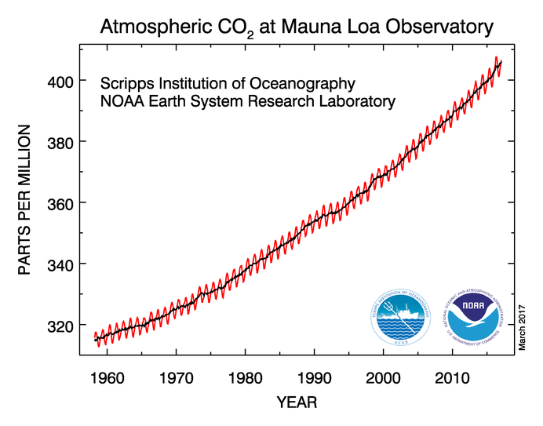
What will you learn during this module?
(1) How the ocean controls the CO₂ and O₂ concentration in the atmosphere

Slide 7
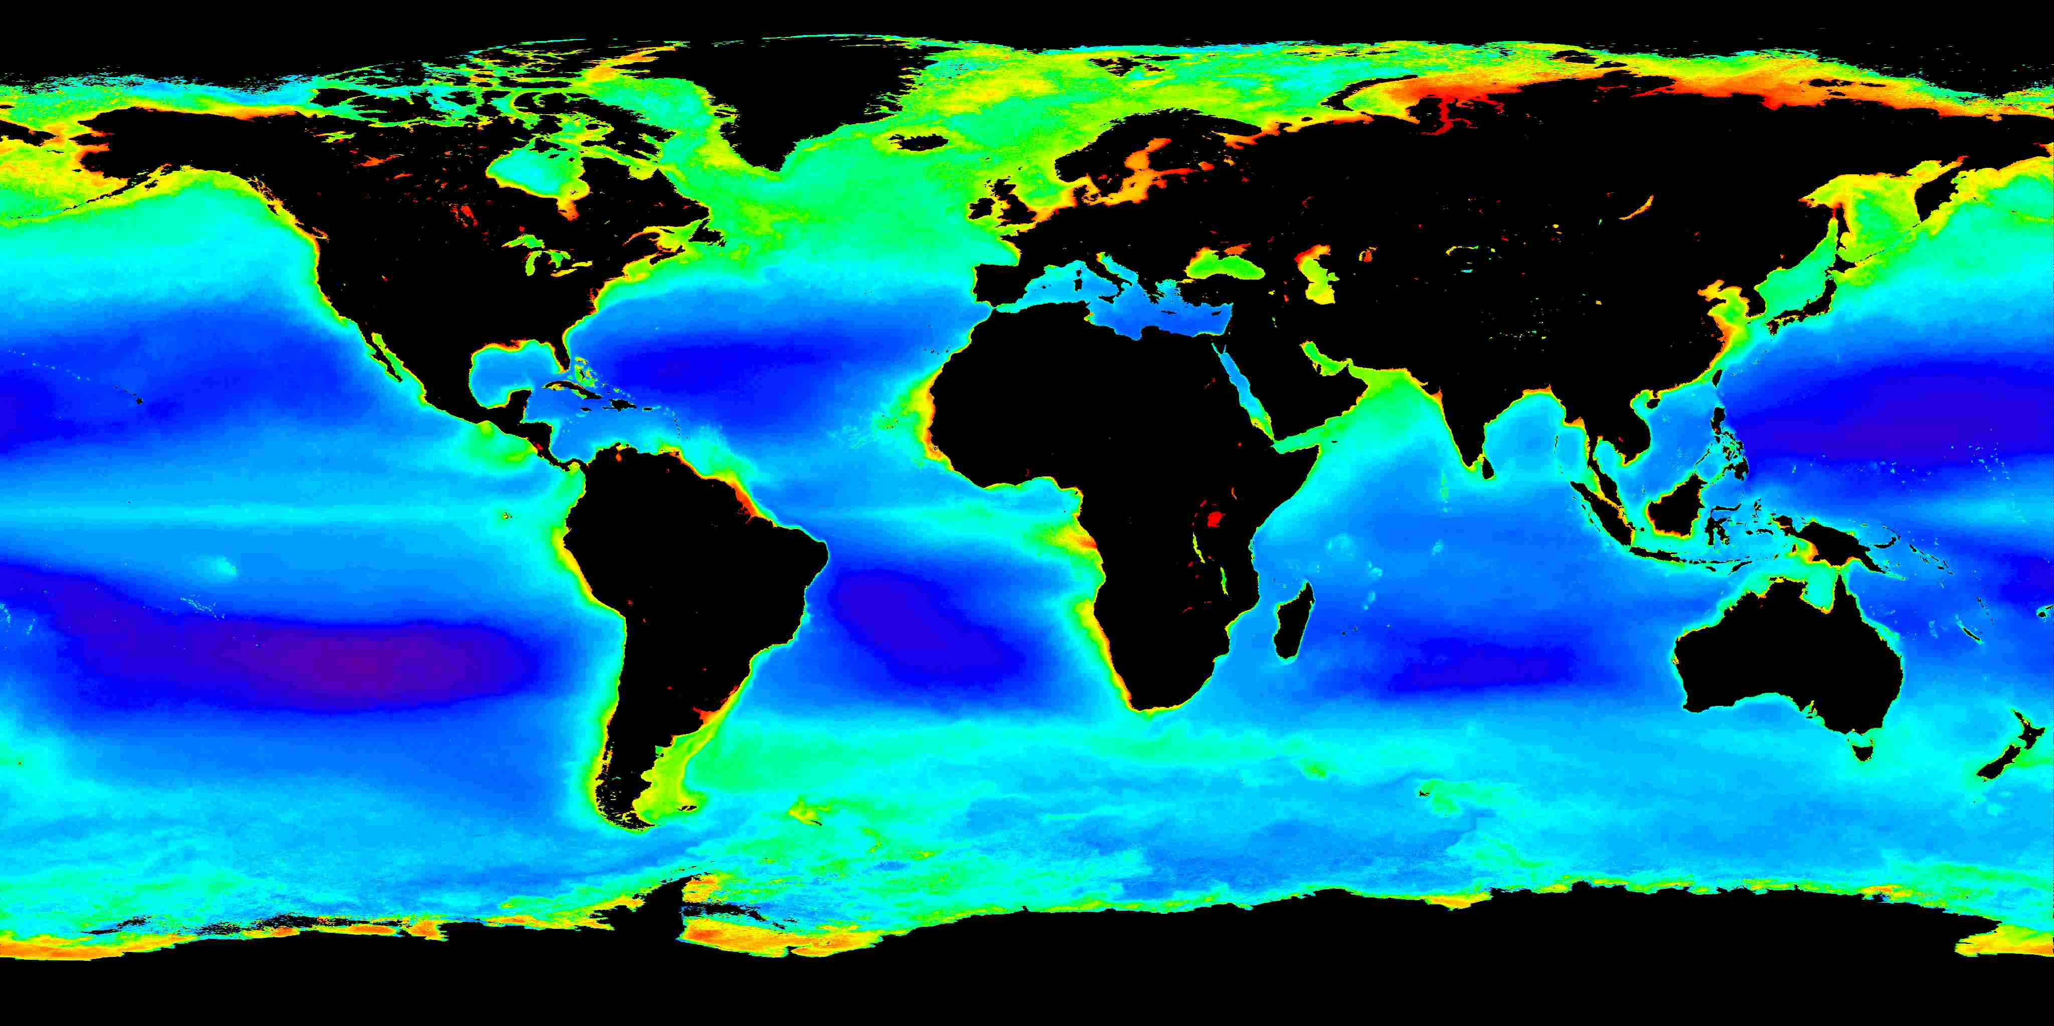
What will you learn during this module?
(2) The major controls on ocean productivity

Slide 8
Chemistry basics

Slide 9
Organic vs. inorganic

Slide 10
Organic vs. inorganic
“The main difference is the presence of a carbon atom; organic compounds will contain a carbon atom (and often a hydrogen atom, to form hydrocarbons), while almost all inorganic compounds do not contain either of those two atoms”
“In chemistry terms, organic means that a molecular has a carbon backbone, with some hydrogens thrown in for good measure. Living creatures are made of various kinds of organic compounds”

Slide 11
Organic vs. inorganic
“The main difference is the presence of a carbon atom; organic compounds will contain a carbon atom (and often a hydrogen atom, to form hydrocarbons), while almost all inorganic compounds do not contain either of those two atoms”
“In chemistry terms, organic means that a molecular has a carbon backbone, with some hydrogens thrown in for good measure. Living creatures are made of various kinds of organic compounds”
Organic or inorganic?
Nitrate: NO₃⁻ inorganic CO₂ inorganic
Ammonium: NH₄⁺ inorganic bicarbonate: HCO₃⁻ inorganic
Urea: CH₄N₂O organic carbonate: CO₃²⁻ inorganic

Slide 12
Organic vs. inorganic
“The main difference is the presence of a carbon atom; organic compounds will contain a carbon atom (and often a hydrogen atom, to form hydrocarbons), while almost all inorganic compounds do not contain either of those two atoms”
“In chemistry terms, organic means that a molecular has a carbon backbone, with some hydrogens thrown in for good measure. Living creatures are made of various kinds of organic compounds”
Organic or inorganic?
Nitrate: NO₃⁻ inorganic CO₂ inorganic
Ammonium: NH₄⁺ inorganic bicarbonate: HCO₃⁻ inorganic
Urea: CH₄N₂O organic carbonate: CO₃²⁻ inorganic

Slide 13
Organic vs. inorganic
“The main difference is the presence of a carbon atom; organic compounds will contain a carbon atom (and often a hydrogen atom, to form hydrocarbons), while almost all inorganic compounds do not contain either of those two atoms”
“In chemistry terms, organic means that a molecular has a carbon backbone, with some hydrogens thrown in for good measure. Living creatures are made of various kinds of organic compounds”
Organic or inorganic?
Nitrate: NO₃⁻ inorganic CO₂ inorganic
Ammonium: NH₄⁺ inorganic bicarbonate: HCO₃⁻ inorganic
Urea: CH₄N₂O organic carbonate: CO₃²⁻ inorganic

Slide 14
Organic vs. inorganic
“The main difference is the presence of a carbon atom; organic compounds will contain a carbon atom (and often a hydrogen atom, to form hydrocarbons), while almost all inorganic compounds do not contain either of those two atoms”
“In chemistry terms, organic means that a molecular has a carbon backbone, with some hydrogens thrown in for good measure. Living creatures are made of various kinds of organic compounds”
Organic or inorganic?
Nitrate: NO₃⁻ inorganic CO₂ inorganic
Ammonium: NH₄⁺ inorganic bicarbonate: HCO₃⁻ inorganic
Urea: CH₄N₂O organic carbonate: CO₃²⁻ inorganic

Slide 15
Organic vs. inorganic
“The main difference is the presence of a carbon atom; organic compounds will contain a carbon atom (and often a hydrogen atom, to form hydrocarbons), while almost all inorganic compounds do not contain either of those two atoms”
“In chemistry terms, organic means that a molecular has a carbon backbone, with some hydrogens thrown in for good measure. Living creatures are made of various kinds of organic compounds”
Organic or inorganic?
Nitrate: NO₃⁻ inorganic CO₂ inorganic
Ammonium: NH₄⁺ inorganic bicarbonate: HCO₃⁻ inorganic
Urea: CH₄N₂O organic carbonate: CO₃²⁻ inorganic

Slide 16
Organic vs. inorganic
“The main difference is the presence of a carbon atom; organic compounds will contain a carbon atom (and often a hydrogen atom, to form hydrocarbons), while almost all inorganic compounds do not contain either of those two atoms”
“In chemistry terms, organic means that a molecular has a carbon backbone, with some hydrogens thrown in for good measure. Living creatures are made of various kinds of organic compounds”
Organic or inorganic?
Nitrate: NO₃⁻ inorganic CO₂ inorganic
Ammonium: NH₄⁺ inorganic bicarbonate: HCO₃⁻ inorganic
Urea: CH₄N₂O organic carbonate: CO₃²⁻ inorganic

Slide 17
Organic vs. inorganic
“The main difference is the presence of a carbon atom; organic compounds will contain a carbon atom (and often a hydrogen atom, to form hydrocarbons), while almost all inorganic compounds do not contain either of those two atoms”
“In chemistry terms, organic means that a molecular has a carbon backbone, with some hydrogens thrown in for good measure. Living creatures are made of various kinds of organic compounds”
Organic or inorganic?
CO₂ inorganic
bicarbonate: HCO₃⁻ inorganic
carbonate: CO₃²⁻ inorganic

Slide 18
Organic vs. inorganic
“The main difference is the presence of a carbon atom; organic compounds will contain a carbon atom (and often a hydrogen atom, to form hydrocarbons), while almost all inorganic compounds do not contain either of those two atoms”
“In chemistry terms, organic means that a molecular has a carbon backbone, with some hydrogens thrown in for good measure. Living creatures are made of various kinds of organic compounds”
Organic or inorganic?
CO₂ inorganic
bicarbonate: HCO₃⁻ inorganic
carbonate: CO₃²⁻ inorganic

Slide 19
Organic vs. inorganic
“The main difference is the presence of a carbon atom; organic compounds will contain a carbon atom (and often a hydrogen atom, to form hydrocarbons), while almost all inorganic compounds do not contain either of those two atoms”
“In chemistry terms, organic means that a molecular has a carbon backbone, with some hydrogens thrown in for good measure. Living creatures are made of various kinds of organic compounds”
Organic or inorganic?
CO₂ inorganic
bicarbonate: HCO₃⁻ inorganic
carbonate: CO₃²⁻ inorganic
Dissolved inorganic carbon (DIC) = CO₂ + HCO₃⁻ + CO₃²⁻

Slide 20
Molarity (molar concentration)
Concentration = moles/volume
= n/V
= mol/L or M (molar)
example: 20 moles in 1 L = 20 mol/L = 20 molar = 20 M
1 L = 1000 mL (milli; 10⁻³)
1 mL = 1000 μL (micro; 10⁻⁶)
1 μL = 1000 nL (nano; 10⁻⁹)
1 mol = 1000 mmol (milli; 10⁻³)
1 mmol = 1000 μmol (micro; 10⁻⁶)
1 μmol = 1000 nmol (nano; 10⁻⁹)
In the ocean, most concentrations of interest are in μM (nutrients) or nM (trace metals)

Slide 21
What is a mole? (mol)
SI unit for the amount of a chemical substance that contains as many elemental entities (e.g., atoms, molecules, photons) as there are atoms in 12 grams of carbon-12 (¹²C).
This number is Avogadro’s constant: 6.022140857 x 10²³ mol⁻¹
1 mole of CaCO₃ contains 1 mole of Ca²⁺ and 1 mole of CO₃²⁻
and 1 mole of CO₃²⁻ contains 1 mole of C and 3 moles of O
1 mole of H₂SO₄ contains 2 moles of H⁺ and 1 mol of SO₄²⁻
where 1 mole of SO₄²⁻ contains 1 mole of S and 4 moles of O
1 mole of Al₂(SO₄)₃ contains 2 moles of Al³⁺ and 3 moles of SO₄²⁻
How many moles of S and O does 3 moles of Al₂(SO₄)₃ contain?

Slide 22
What is a mole? (mol)
SI unit for the amount of a chemical substance that contains as many elemental entities (e.g., atoms, molecules, photons) as there are atoms in 12 grams of carbon-12 (¹²C).
This number is Avogadro’s constant: 6.022140857 x 10²³ mol⁻¹
1 mole of CaCO₃ contains 1 mole of Ca²⁺ and 1 mole of CO₃²⁻
and 1 mole of CO₃²⁻ contains 1 mole of C and 3 moles of O
1 mole of H₂SO₄ contains 2 moles of H⁺ and 1 mol of SO₄²⁻
and 1 mole of SO₄²⁻ contains 1 mole of S and 4 moles of O
1 mole of Al₂(SO₄)₃ contains 2 moles of Al³⁺ and 3 moles of SO₄²⁻
How many moles of S and O does 3 moles of Al₂(SO₄)₃ contain?

Slide 23
Molality (molal concentration)
Molality is defined as the number of moles of a solute per kilogram of solvent.
SI unit for molality is mol/kg
example: 20 moles in 1 kg = 20 mol/kg = 20 molal = 20 m
In the ocean, geochemists will use mol/kg (μmol/kg) because the density of seawater > 1 kg/L.
Density of seawater = 1.029 kg/L
What is the molality of 20 μM nitrate in seawater?

Slide 24
Concentrations of solutions
I want to make a 10 μM solution of ammonium in a 300 mL flask using ammonium chloride (NH₄Cl) salt. What mass of NH₄Cl should I add?
0.1065 mg
Homework:
You want to make a 20 mM solution of hydroxide (OH-) in a a 500 mL flask using barium hydroxide (Ba(OH)₂) salt. What mass of Ba(OH)₂ do you need to add?

Slide 25
Concentrations of solutions
I want to make a 10 μM solution of ammonium in a 300 mL flask using ammonium chloride (NH₄Cl) salt. What mass of NH₄Cl should I add?
0.1065 mg
Homework:
You want to make a 20 mM solution of hydroxide (OH-) in a a 500 mL flask using barium hydroxide (Ba(OH)₂) salt. What mass of Ba(OH)₂ do you need to add?

Slide 26
Concentrations of solutions
Sometimes chemical oceanographers will use concentration units of mmol/m³. What is a mmol/m³?
1 mmol = ? μmols
1 m³ = ? L

Slide 27
Concentrations of solutions
Sometimes chemical oceanographers will use concentration units of mmol/m³. What is a mmol/m³?
1 mmol = ? μmols
1 m³ = ? L
1 mmol/m³ = 1 μmol/L
Okay, so now what if density is in kg/m³?
1 kg = ? g
1 m³ = ? L
1 kg/m³ = 1 g/L

Slide 28
Concentrations of solutions
Sometimes chemical oceanographers will use concentration units of mmol/m³. What is a mmol/m³?
1 mmol = ? μmols
1 m³ = ? L
1 mmol/m³ = 1 μmol/L
Okay, so now what if density is in kg/m³?
1 kg = ? g
1 m³ = ? L
1 kg/m³ = 1 g/L

Slide 29
Concentrations of solutions
Sometimes chemical oceanographers will use concentration units of mmol/m³. What is a mmol/m³?
1 mmol = ? μmols
1 m³ = ? L
1 mmol/m³ = 1 μmol/L
Okay, so now what if density is in kg/m³?
1 kg = ? g
1 m³ = ? L
1 kg/m³ = 1 g/L

Slide 30
Concentrations of solutions
Sometimes chemical oceanographers will use concentration units of mmol/m³. What is a mmol/m³?
1 mmol = ? μmols
1 m³ = ? L
1 mmol/m³ = 1 μmol/L
Okay, so now what if density is in kg/m³?
1 kg = ? g
1 m³ = ? L
1 kg/m³ = 1 g/L

Slide 31
Dilutions
C₁V₁ = C₂V₂ (C is concentration; V is volume)
Example: You have a 1 mM solution of NaNO₃ (solution 1). You want to make a 50 μM NO₃⁻ solution in a 250 mL flask by diluting solution 1 with water. What volume of solution 1 is required?
12.5 mL

Slide 32
Dilutions
C₁V₁ = C₂V₂ (C is concentration; V is volume)
Example: You have a 1 mM solution of NaNO₃ (solution 1). You want to make a 50 μM NO₃⁻ solution in a 250 mL flask by diluting solution 1 with water. What volume of solution 1 is required?
12.5 mL

Slide 33
Exercise
How many moles of Al³⁺ and SO₄²⁻ does 1 mole of Al₂(SO₄)₃ contains? How many moles of S and O do 3 moles of Al₂(SO₄)₃ contain?
You want to make a 20 mM solution of hydroxide (OH⁻) in a 500 mL flask using barium hydroxide (Ba(OH)₂) salt. What mass of Ba(OH)₂ do you need to add?
What is the molality of 2025 μM of DIC in seawater if the density of seawater is 1027 kg/m³?
One plankton cell can transport 10 picograms (pg) of nitrogen (N) per second. How many μmols of N can 1 million plankton cells transport in a second? How many moles of N can 1 million plankton transport in 1 year?
You have a 2 mM solution of K₃PO₄. You want to make a 30 μM PO₄³⁻ solution in a 100 mL flask by dilution with water. What volume of K₃PO₄ is required?

